Slide 1


School of Sanctuary

Slide 2
Background/ Context
Kirkdale St Lawrence Church of England Primary School is located in Kirkdale, Liverpool.
Currently there are around 307 children on roll.
Nearly half of the pupils are eligible for Free School Meals (FSM), 47%
The number of children on the Special Educational Needs and Disabilities (SEND) register is 22%
This is increased significantly in the last 4 years with an increase from 23%-now 49%
We were awarded the School of Sanctuary Award in 2020.

Slide 3
There are over 45 different languages spoken in our school?
Approximately 40-50 of our children are refugees or people seeking asylum
Half of the cohort speak English as an Additional language(EAL), 49%. Both figures are significantly above national averages.

Slide 4


We had Statutory Inspection of Anglican and Methodist Schools (SIAMS) Overall rating as GOOD- December 22.
IQM Inclusive School Award- We are now a Centre of Excellence- June 2023
Kirkdale St Lawrence Achieves Centre of Excellence | IQM (iqmaward.com)

Slide 5
How we have worked towards the reaccreditation for SCHOOL OF SANCTUARY
The first thing we did as a SLT was to look at the School of Sanctuary Self-Assessment Tool.
R
A
G
We then looked at how we could incorporate areas for development in our School Development Plan.

Slide 6
How do we support our children?
A clear EAL and Inclusion Policy and Action Plans to support next steps
Good CPD for ALL staff- are staff aware of what EAL children need?
Staff Induction
Regular Staff meetings- EAL staff meeting April 23
Our school Values- Compassion, Trust, Thankfulness, Courage, Hope
Pastoral support (Pastoral Team)
Trauma Informed Practice (Hearts Project)

Slide 7
How do we support our children? cont.
Practical activities as much possible (adapted teaching).
Welcoming classroom (home-language)
Dual Language resources
Technology- Google translate/ EMAS UK
Adult support (LSAs/ EMTAS)
Encourage use of home language to consolidate learning (letters, coffee mornings, induction program.

Slide 8
How do we support our children?
Induction Program- with interpreter if required (Beesdialect), uniforms, food parcel support (bespoke for refugee or asylum)
Peer support and paired/groups activities (adapted teaching)
Assemblies, Picture News, Themed weeks/ days (Refugee Week, Black History Month, Mother Tongue Day).
Revised assessment for EAL children (Nassea, Wellcomm, Language Plans, Ranking system, Language acquisition assessment).
Cornerstones Curriculum
,
Extracurricular clubs- Cooking across the continents

Slide 9
Well- Being Support/ SEN Support
Yoga
Seedlings/ YPAS
ADHD Foundation
MAST
Gang Culture Education (James Riley)
EiTC
LFC Foundation
Peace Foundation

Slide 10
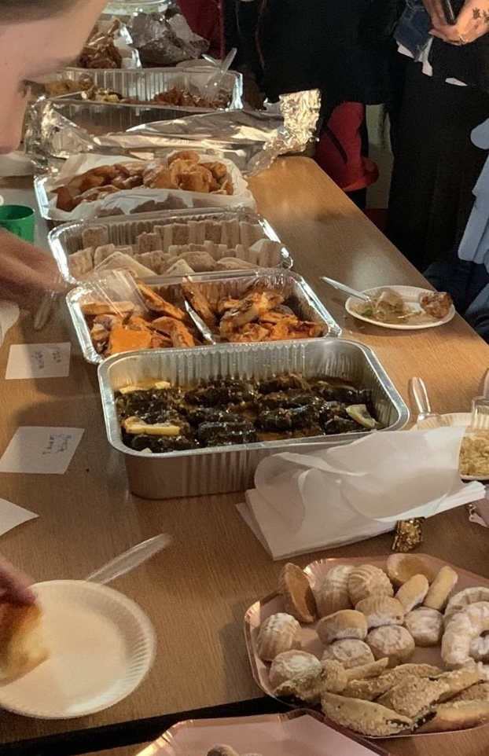
How do we support our parents/ carers?
Induction to school program
Pastoral Team
Open door- (uniform, food parcels, support with letters, housing)
Clothing events
Fareshare
Events (Eid Party Day, Food Festival, Coffee mornings, Parents courses, Parent open days, curriculum days)
Safeguarding Team
Website – translator app/ EMAS UK

Slide 11
How do we support our parents/ carers? Cont.
ESOL- Entry level 1 and speaking and listening work-shop
Free breakfast club for ALL
Targeted financial support
Family Support Service
Welfare Officer employed by school
Trips/ residentials subsidised

Slide 12
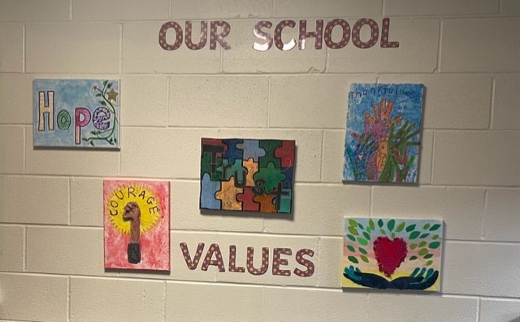

Slide 13
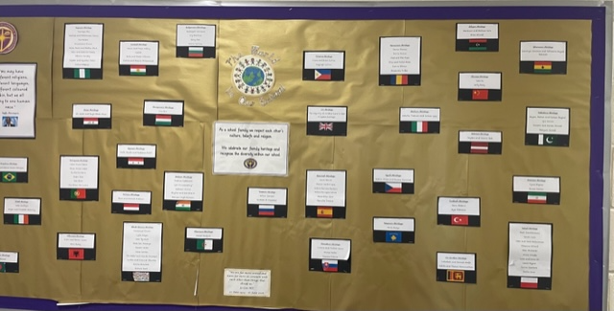

Slide 14
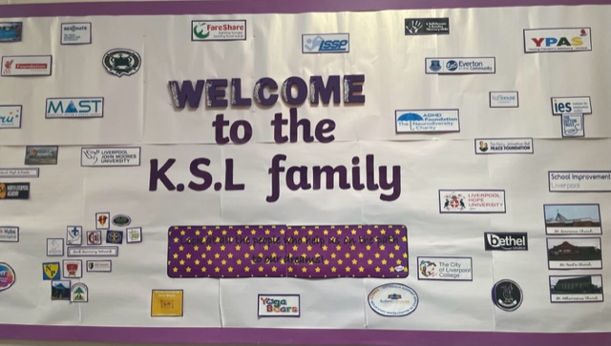

Slide 15
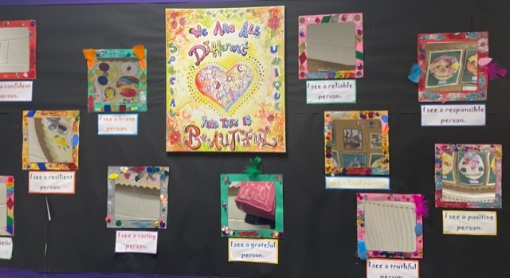

Slide 16
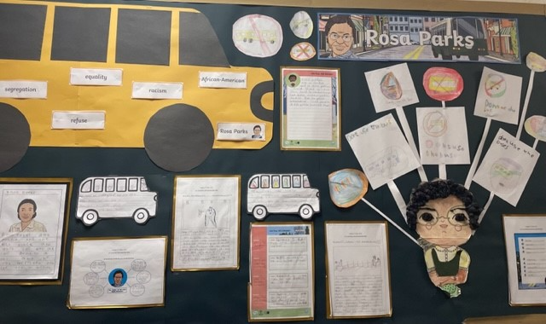
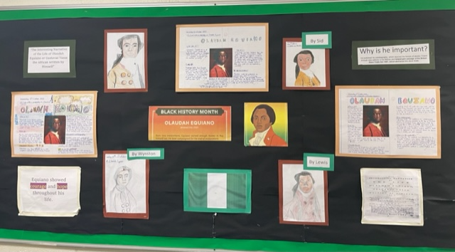
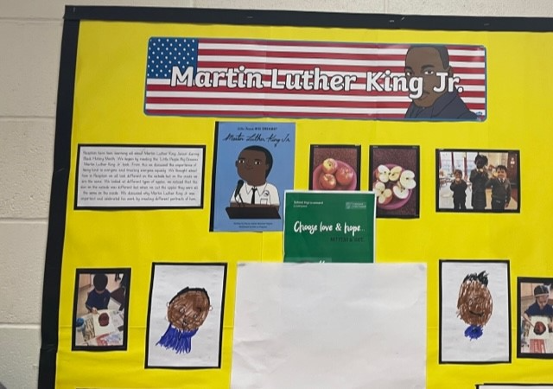
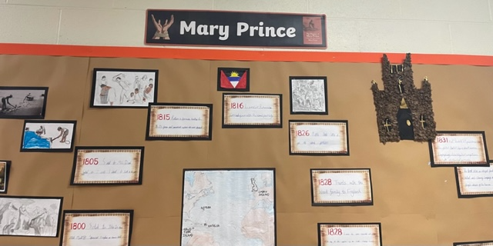

Slide 17
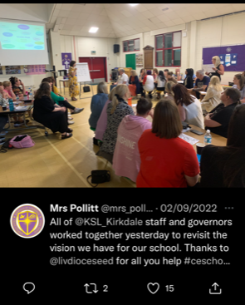
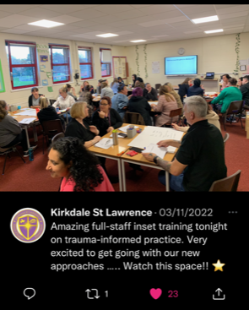

Slide 18


Kirkdale, St Lawrence CE Primary School - Mental Health and Well-Being (kirkdalestlawrence.com)
Kirkdale, St Lawrence CE Primary School - School of Sanctuary (kirkdalestlawrence.com)

Slide 19
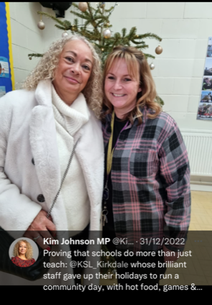
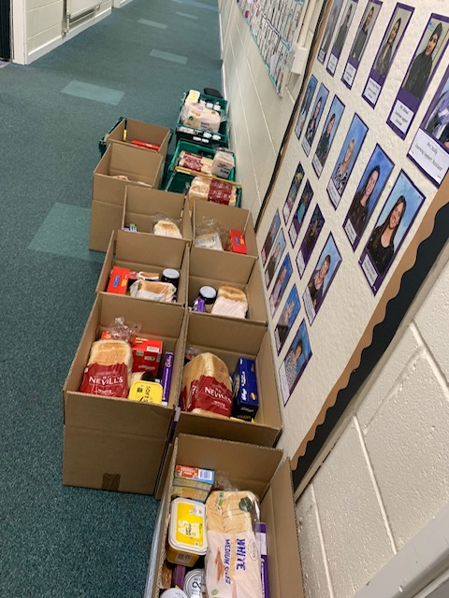

Slide 20
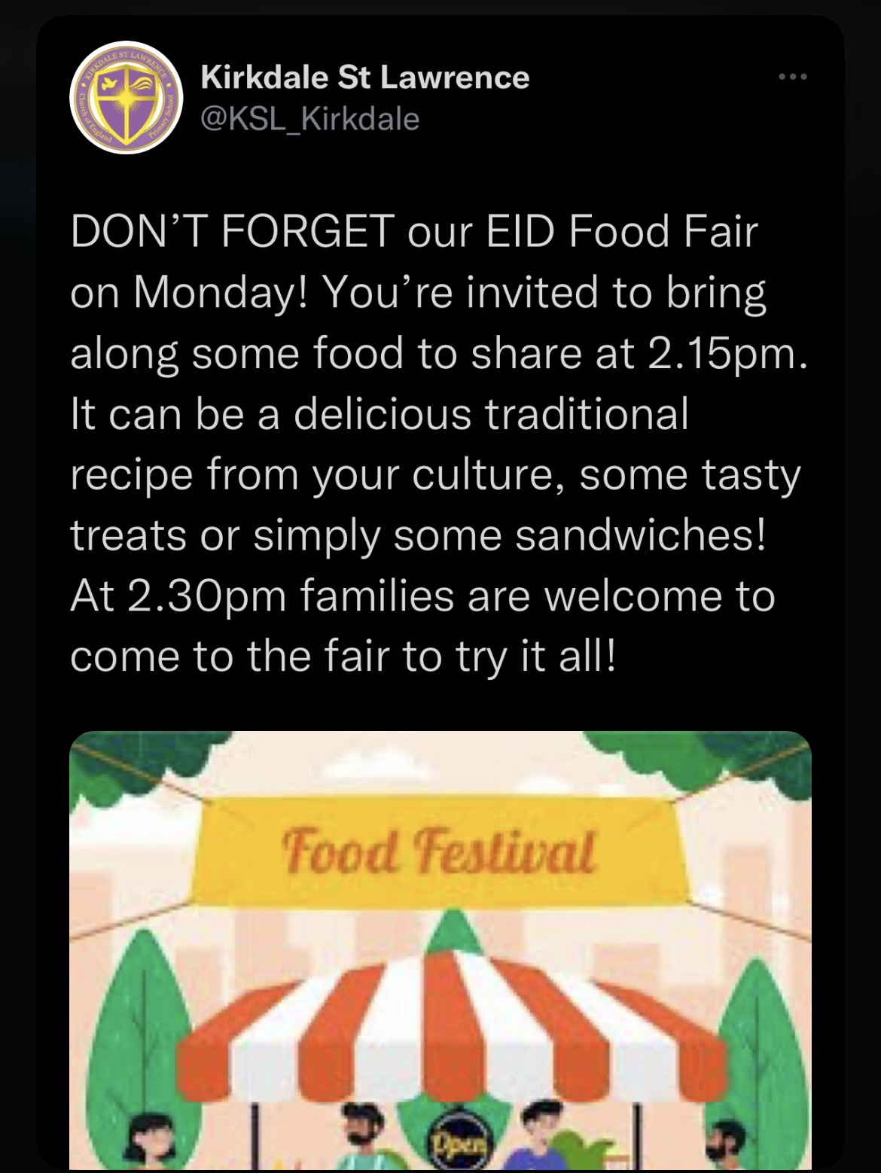
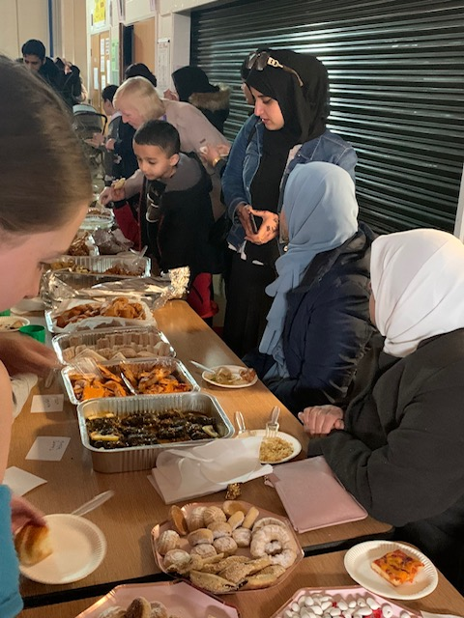
(2) Mrs England (@MissEngland9) / Twitter

Slide 21
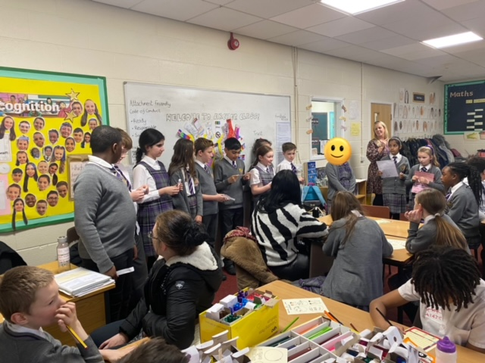
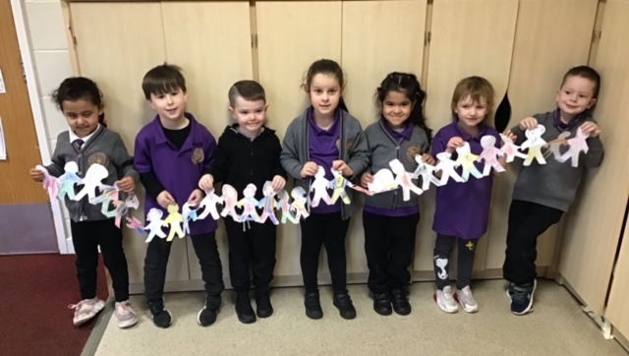

Slide 22
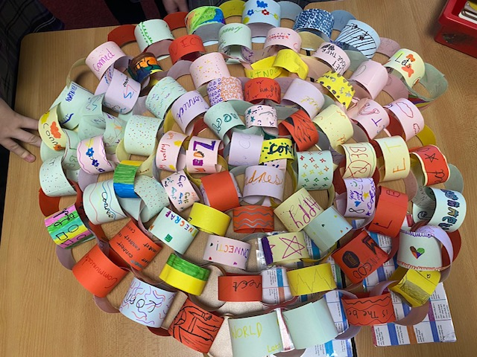
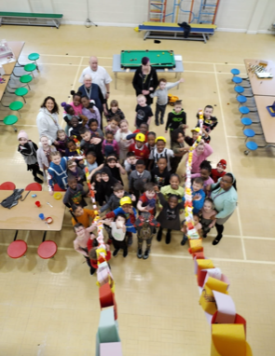

Slide 23
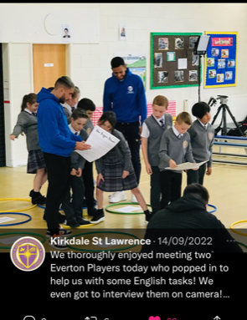
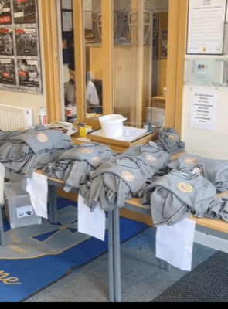

Slide 24
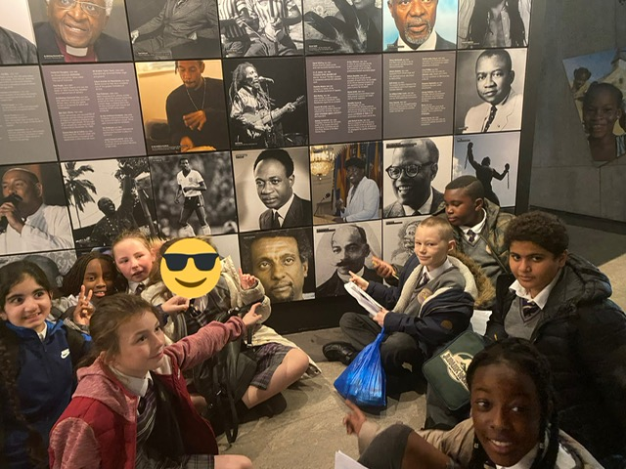

Slide 25
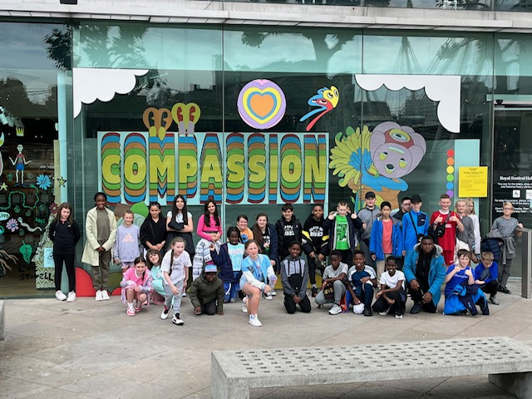

Slide 26
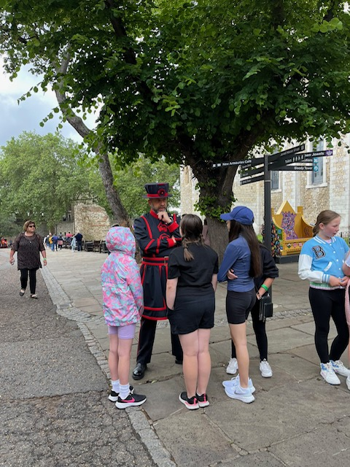
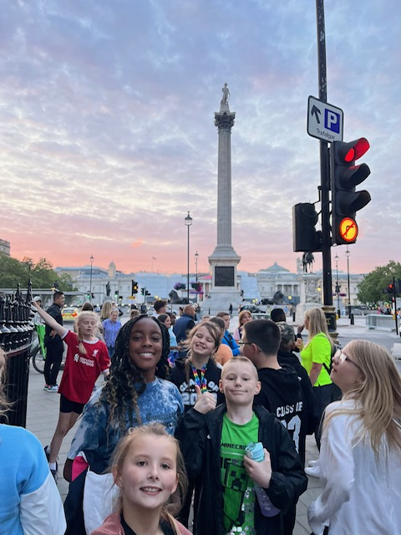

Slide 27
Military School UK
U.K Military School on Twitter: "An absolute pleasure to film with @KSL_Kirkdale and amazed to hear such positive feedback. For those who’ve worked with us know the impact but for those who yet haven’t .. why are you waiting ?? We’ll enrich your curriculum and motivate your learners to be the best they can be https://t.co/zA9NAUWwrd" / Twitter

Slide 28
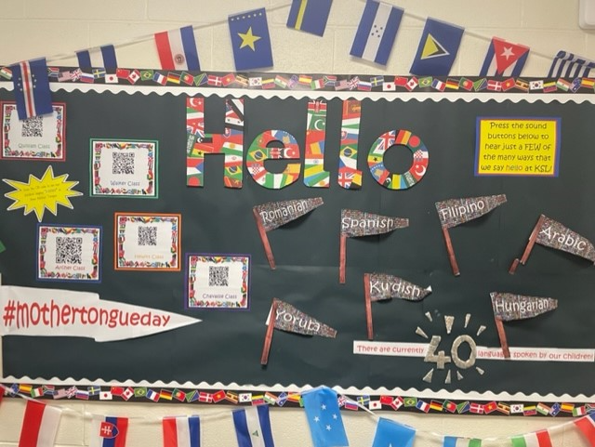
Mother Tongue Day
Miss McNeill on Twitter: "Celebrating #MotherTongueDay in Archer class💜⭐️ @KSL_Kirkdale https://t.co/1y9968JKvx" / Twitter
Mrs Islam on Twitter: "Walker Class say ”Hello” using their ‘mother tongue’ #MotherTongueDay 🌟😀@KSL_Kirkdale https://t.co/vk3Ed8riwM" / Twitter

Slide 29
Next Steps
Global links – Developing Cultural heritage days whereby we could invite wider members of the community to deliver workshops and events for the children to celebrate the wide range of languages and cultures pertaining to the school community.
Purchase more dual-language resources for use in school and at home
The school engages/ collaborates further with the local City of Sanctuary groups.

